Slide 1
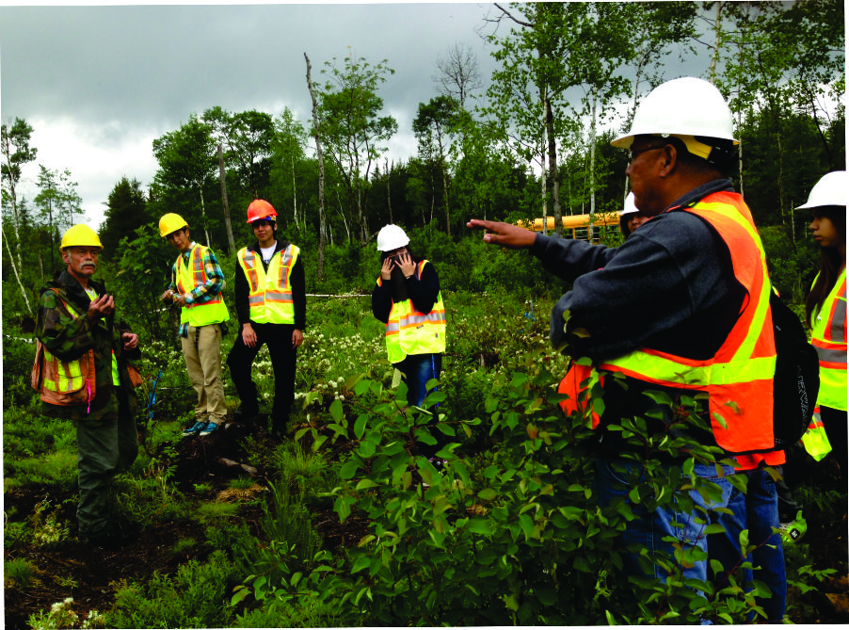
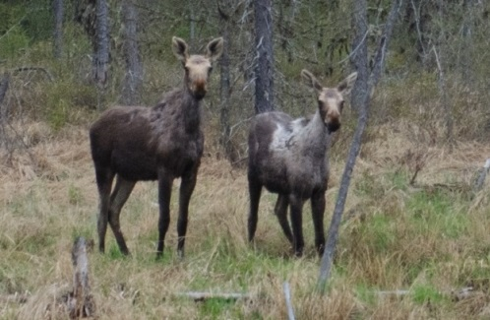
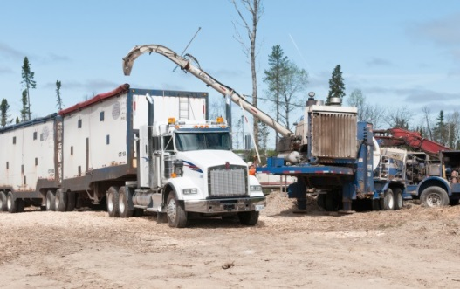
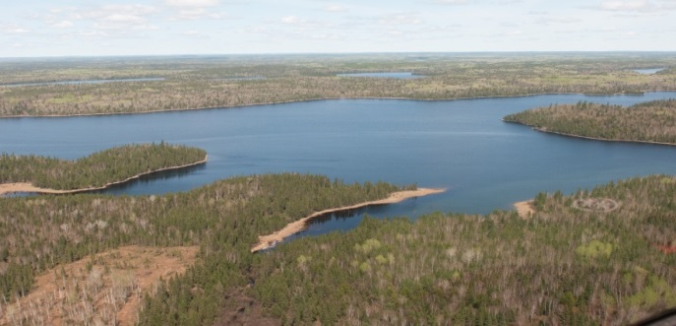
Obishikokaang Resources Lac Seul Forest
NAFA National Meeting
Saskatoon, SK
December 3rd, 2014
Chief Clifford Bull
Lac Seul First Nation

Slide 2
An Overview of Lac Seul First Nation
Lac Seul First Nation is the largest reserve in the Grand Council Treaty #3.
Lac Seul Indian Reserve No. 28 is approximately 26,800 ha (104 sq.mi.), and was established in 1886.
Lac Seul I.R. 28 contains 3 main communities:
Frenchman’s Head (pop. 477)
Kejick Bay (pop. 370)
Whitefish Bay (pop. 93)

Slide 3
Lac Seul Forest
Located in NW Ontario, the Lac Seul Forest has been managed by the Lac Seul First Nation since 2012
Large forest, covering over 1 million ha in the boreal region of Canada
The management of this forest has provided the community with significant training, capacity building and economic development opportunities

Slide 4
Obishikokaang Resources Corporation
Management Company representing LSFN
Reports to a Forestry Committee made up of Band members and representatives of Council
Responsible for forest operations and management, finance, economic development and capacity building related to the implementation of the Lac Seul Forest Management Plan.
Signing of the 5 year forestry license July 2012

Slide 5
Obishikokaang Resources Corporation
Goal of this organization is to work closely with Chief and Council to maximize economic development opportunities associated with managing the Lac Seul Forest
Capacity Building
Environmental Compliance
Economic Flow of Fibre to area Mills
Leverage the wood supply from the forest to establish long term sustainable economic growth for both the community and the surrounding region.

Slide 6
Industry Partnerships
Critical to our early and continued success
Established credibility with local contractors through a completely transparent approach
Negotiated a unique agreement with Domtar, providing early financial stability
Signing the license did not provide cash flow but we have managed ORC financially independent of LSFN

Slide 7
Sustainable Forest Management
Truly a complex balancing act, attempting to ensure wood flows while protecting environmental and social values associated with the forest
Real trick is maintaining a suitable level of environmental protection while ensuring access to traditional uses while ensuring the remoteness of the forest

Slide 8
Forest Management
Compliance to the Crown Forest Sustainability Act through the implementation of the Forest Management Plan is exhaustive and expensive. Significant liabilities exist with signing a forestry license
It does provide the foundation for economic development through the allocation of forest resources and the ability to take a lead in decision making

Slide 9
Added Value Facility
Remains the focus of Chief and Council
Continue to meet with and discuss options with various organizations
Wood supply does not currently provide an easy access into the market Interested in discussing options with our friends in industry and learning what new initiatives are being evaluated

Slide 10
Capacity Building
Long term goal is to integrate community members into all aspects of forest management
Currently have a solid team of professionals in place to help manage Obishikokaang Resources and integrate and train community members.
10 staff, including 4 full time band members in addition to numerous seasonal employment opportunities in forestry

Slide 11
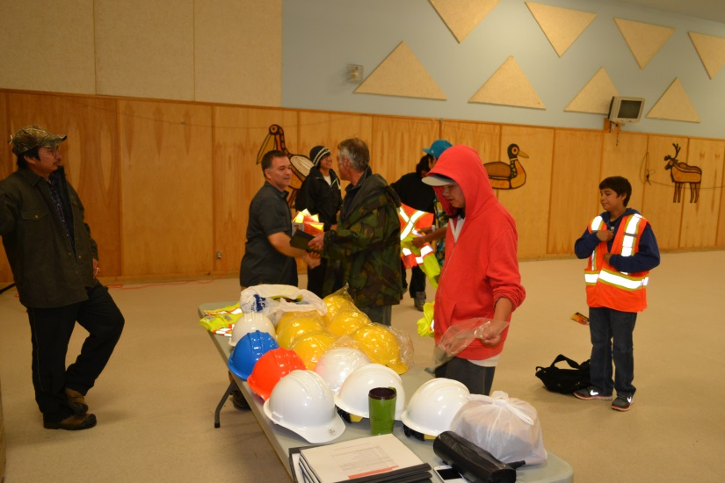
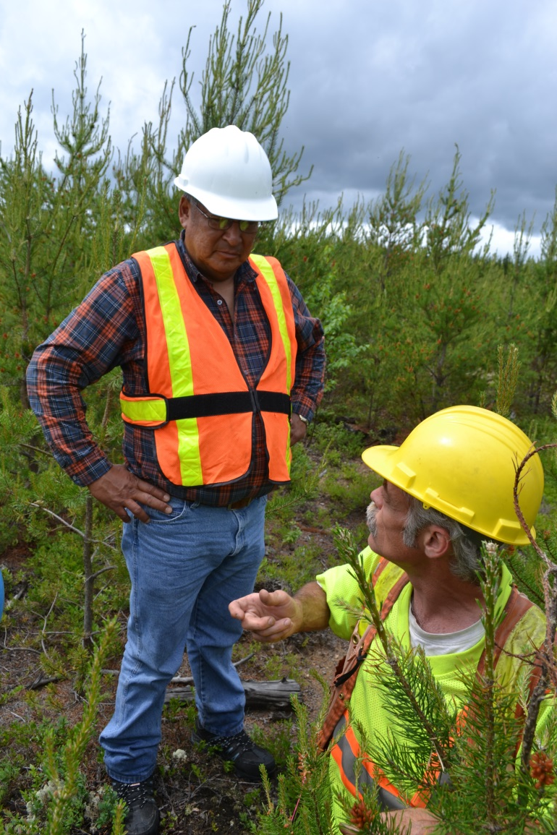
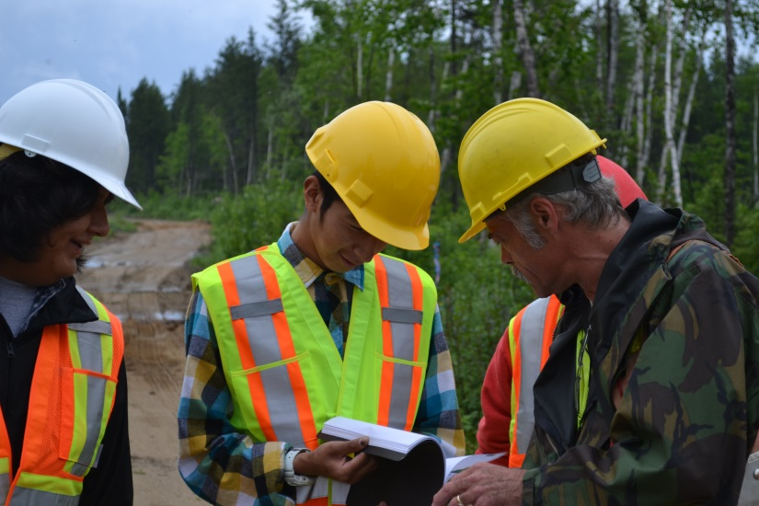
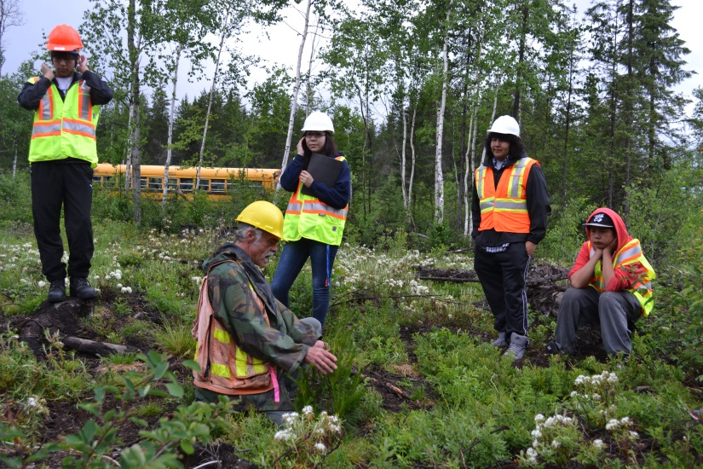

Slide 12
Capacity Building
Strong commitment to educating our young people with respect to forestry and the employment opportunities related to managing the forest
Summer Student Silviculture program
Outreach program with area schools
Scholarship for local students in forestry or environmental university and college programs

Slide 13
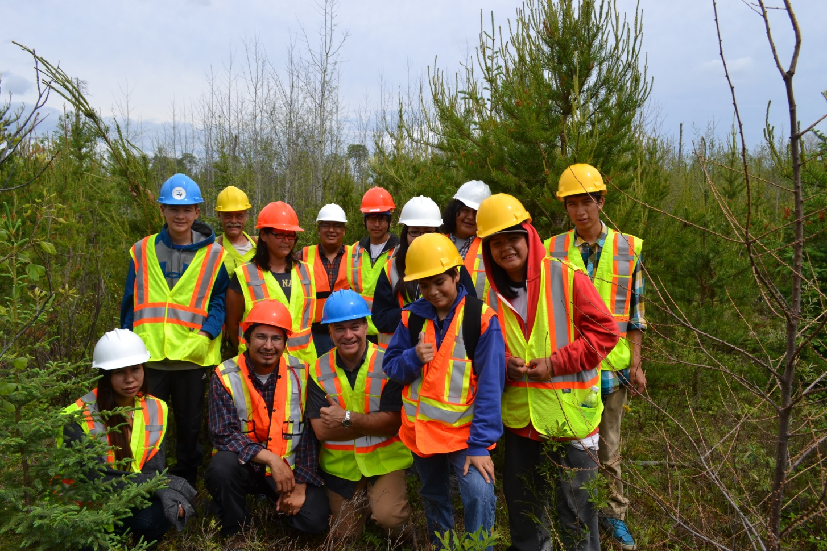
Miigwech

Slide 14
Managing Expectations
Forest Management is complicated
Difficult to keep everyone happy
Integrating the First Nation’s requirements represents an important component
Balancing capacity building with the existing economic realities of wood costs
Our team of forestry professionals have been key to helping us understand the balance

Slide 15
Obishikokaang Resources
Represents a real success story
It is working, wood is flowing, we remain cash positive
Forest Management Plan is being successfully implemented
Community members are working

Slide 16
Moving Forward
First Nations will continue to play and increasing positive role in Natural Resource Management
Expectations are high, so are the stakes
Positive Dialogue key to success

